Slide 1

Cloud vs. Non-Cloud Segmentation
McCombs School of Business, MSBA 2020
May 1, 2020
Edward Eustachon - Tushar Gupta - Jeremy Friedman - Sachin Balakrishnan

Slide 2
Roadmap
Project Overview
Data Processing
Analysis: Classification
Analysis: Clustering
Results & Findings

Slide 3
Project Overview
01
Fortune 500 company which...
Provides enterprise level storage
Facilitates business value by helping customers manage their cloud storage
What is NetApp?
02
Many customers are moving to cloud
Build a descriptive profile of companies recently migrated to cloud
Predict which companies are likely to move next
Problem Statement
03
3rd party data that records company data and cloud usage
IT budget, industry, country, employee count etc.
Internal NetApp data
NetApp product usage, storage usage, expenses in past year etc.
Data Sources

Slide 4
Data Processing
Aggregate
Aggregate data on the company level
Engineer
Engineer product “stickiness” measures
Sum (total presence)
Percent (relative presence)
Indicator (binary presence)
Encode
Binary encode categorical variables
Impute
Clean and impute missing values using KNN

Slide 5
Analysis: Classification
 | Variable | Percent Importance
0 | US | 7.19%
1 | Total IT Budget | 4.69%
2 | Internal IT Total | 4.20%
3 | External IT Total | 3.27%
4 | External IT to Total IT Ratio | 3.14%
5 | Total Revenue | 3.05%
6 | External IT vs. Internal IT | 2.89%
7 | Total “200” Product Series | 2.59%
8 | Total Employees | 2.51%
9 | Total Features | 2.04%
10 | Total “300” Product Series | 1.89%
Process
Random Forests & XGboost Model tuning negligible Important variables focused on company traits
AUC Score: ~0.75
High false positive rate
Created US/non-US subset to control country imbalance

Slide 6
Analysis: Clustering
Cluster
together similar companies
Detect
outliers in the feature space
Identify
common attributes of on-cloud companies
Map
non-cloud companies to clusters created
Target
non-cloud companies within on-cloud clusters

Slide 7
Feature Selection
Problem |  | Solution
1 | Too many principal components required for 80% variance retained | Use top 50 feature importance from model
2 | High correlation among the top 50 features | Keep uncorrelated features (see below)
Total internal IT spending External vs. internal IT spending
Total Employees Total “200” features
Percent Feature 307 Employee count between 100 & 500
Manufacturing industry identifier

Slide 8
Cluster Profiles
US
Non-US
SMEs
753
Manufacturing SMEs
316
High Budget SMEs
126
External IT Spenders
106
Startups
379
Pro Cloud Manufacturing
74
Brand Ambassadors
82
Pro NetApp
33

Slide 9
Results & Findings: Cluster Performance
US Clusters :
US on-cloud companies in holdout set - 306
71 companies predicted to be on-cloud; 52 were actually on-cloud
73% Precision in the prediction
Non-US Clusters :
Non-US on-cloud companies in holdout set - 278
47 companies predicted to be on-cloud; 28 were actually on-cloud
60% Precision in the prediction

Slide 10
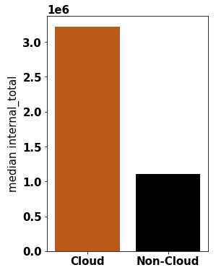
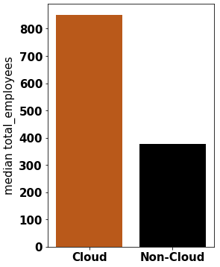
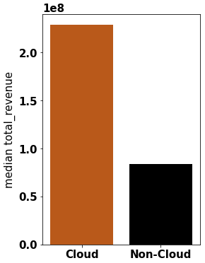
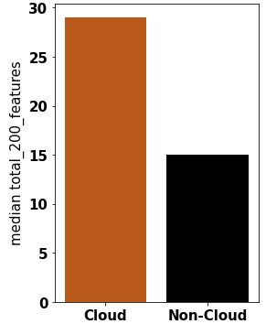
Results & Findings:
Descriptive Profiles
Significant Driving Factors: Cloud vs. Non-cloud
Large sized companies in terms of budget allocation, employee count and total revenue prefer cloud to non-cloud
Cloud companies have a higher percentage of feature 200 usage

Slide 11
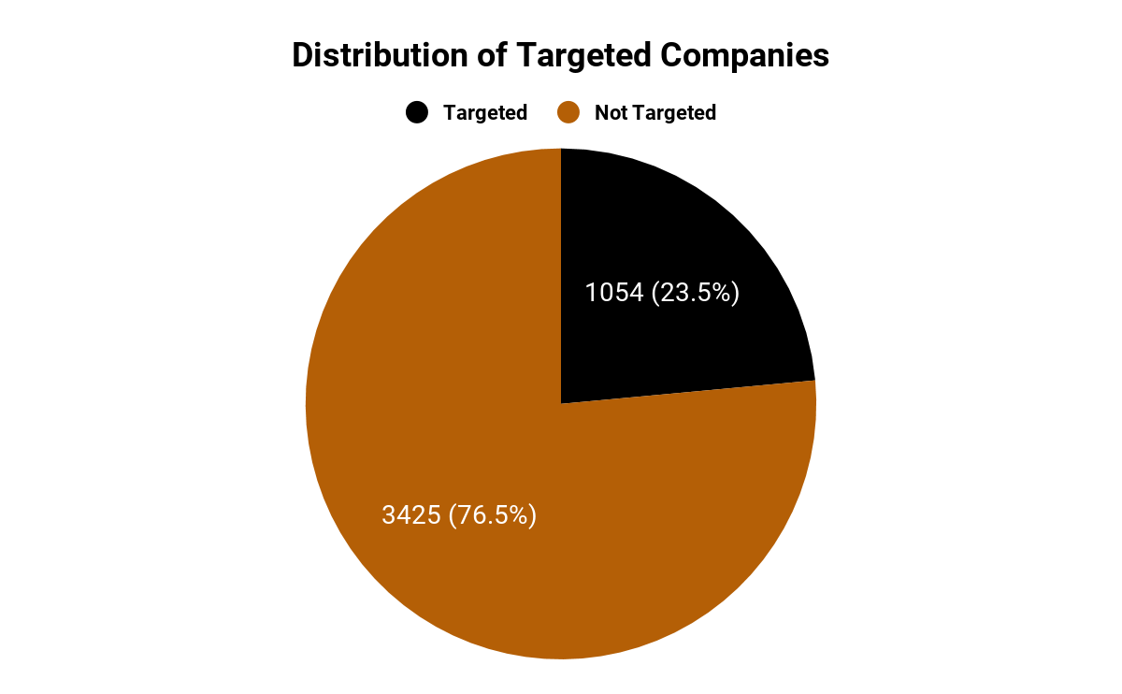
Key Takeaways
Distinctions between the profiles of US and non-US companies
1,054 of 4,479 non-cloud companies fit on-cloud cluster profiles
Expected Lift of Subset: 1.46

Slide 12
Questions?

